Slide 1

Use Case Presentation
Team Blue Steel

Slide 2
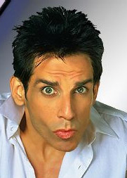
Team introduction

Slide 3

Chip keyes
I’m currently a research technician at Fred Hutchinson Cancer Research doing primarily molecular biology and animal surgery. I was initially premed through college, which is why my background is in life sciences. I was exposed more and more frequently to computer programming via data analysis, which ignited an interest to know more about such an interesting and versatile field. I have 6 courses left in my MS in Computer Science degree and am focusing on a mix between software engineering and data science courses. Personal - My wife and I are expecting our first baby in august, which we’re pumped/nervous about. I also enjoy homebrewing in what little spare time I have left.

Slide 4
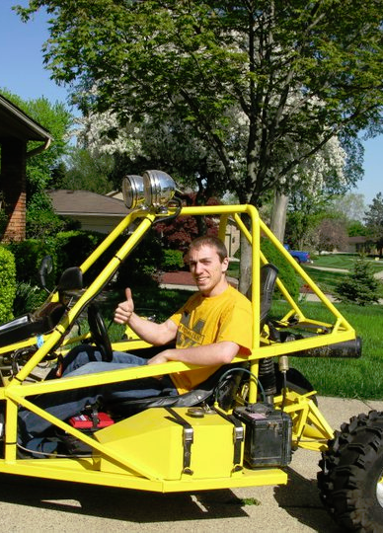
Dan LAGRECA
I’m an embedded systems developer, originally from Michigan. I’m more than half way done with my CS degree from JHU. I have 7 years of programming experience. I enjoy building things that move (Like the dune buggy in the picture) and recently rescued a dog.

Slide 5

Dave Cain
I have over 15 years of experience in software quality assurance much of which was in testing computer games. Currently I work at G2 Web Services where I validate software used by the financial services industry. I anticipate earning my Masters in Information Systems Engineering after this semester.

Slide 6
Assumptions
Kiosks will have power
A method for transporting audiobooks between branches will be available
Kiosk hardware will be in good repair and function as expected
Credit Card data will not be hosted internally

Slide 7
constraints
Physical accessibility of the kiosk. For instance, if the kiosk is located inside the library it may not be accessible 24/7.
Large volume audiobooks which take up more than 1 CD will require special handling.
There may not be enough copies of each audiobook to stock one copy at each kiosk.
The capacity of the kiosk will limit the number of audiobooks that can be stored at each location.

Slide 8
Key stakeholders
Library Owner
Library Operator
Library Admin (IT Staff)
Library Support Staff
System Developer

Slide 9
Use case overview
Title | Goal | Primary Actor
Customer Uses Kiosk | Initiate kiosk transaction | Customer
Customer Browses Audiobook Collection | Browse available audiobooks | Customer
Customer Checks Out | Check out an audiobook | Customer
Customer Picks up Reserved Audiobook | Pick up reserved audiobook | Customer
Customer Returns Audiobook | Return audiobook to kiosk | Customer
Customer Reserves Audiobook | Reserver audiobook using internet | Customer
Library Staff Restocks Kiosk | To restock kiosk with returned audiobooks | Employee
Library Staff Registers new Customer | To register new customer in the system | Employee
Admin runs report | To see system wide activity | Admin
Admin modifies inventory | To change inventory levels | Admin

Slide 10
Actor definitions
Customer – Persons borrowing audiobooks
Library Employee – Local branch staff responsible for stocking audiobooks and registering new users
Library Admins – IT staff responsible for system wide maintenance
System – The Blue Box system itself

